Slide 1

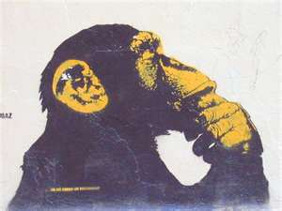
THINKING IS NOT AN OPTION:
How the insights of the behavioral and cognitive sciences can make you a better developer
Suddenly I am hungry…

Slide 2
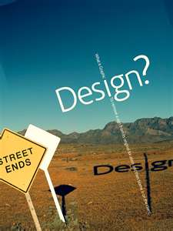

Overview
What is design?
How do you actually think?
How does design change due to our thinking processes?
Overview of first five chapters of Don’t Make Me Think
Will prove thinking is not an option!
Just not like you think of the phrase

Slide 3
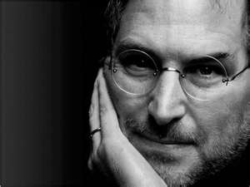
Why are we doing this?
A lot of people in our industry haven't had very diverse experiences.
So they don't have enough dots to connect, and they end up with very linear solutions without a broad perspective on the problem.
The broader one's understanding of the human experience, the better design we will have.

Slide 4
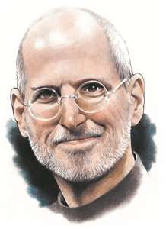
But we aren’t designers, are we?
Design is a funny word.
Some people think design means how it looks.
But of course, if you dig deeper, it's really how it works.

Slide 5
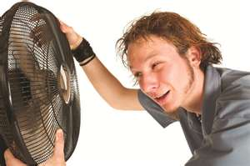
We create how it works
But the user decides how it is used!
If can predict how the user thinks
We can better determine how they will use it
So how do people actually think?
If I could just get my head inside the cage…

Slide 6
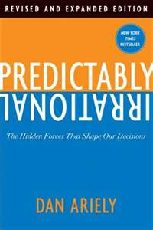
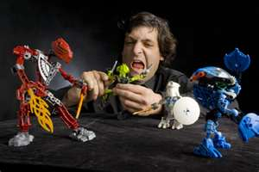
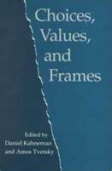
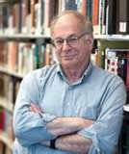
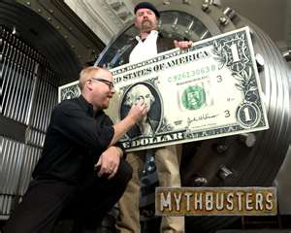
Exposing the Myths
People are not rational actors. People are predictably irrational
Most of the time we think with shortcuts or what are called Heuristics or biases.

Slide 7
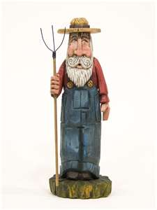
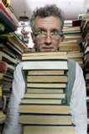
You don’t believe me do you?
Let’s do it like Amos and Daniel did…
An individual was picked at random and has been described by a neighbor as follows: “Steve is very shy and withdrawn, invariably helpful but with little interest in people or in the world of reality. A meek and tidy soul, he has a need for order and, and a passion for detail.” Is Steve more likely a librarian or a farmer?
Is that your final answer?
What if male farmers outnumber male librarians 20 to 1?
You used a bias to make your decision
Base rate neglect

Slide 8
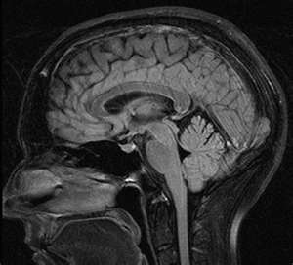
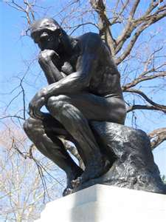
How do we actually think?
Most cognition is non-conscious.
In fact, we think in two very different ways.

Slide 9
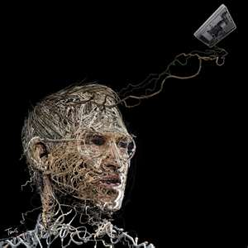
Two different thinking systems
  Type 1 –Automatic, Fast, Intuitive, Emotional, Uncontrollable
  What You Is All There Is (WYSIATI)-Doesn’t question evidence
Creativity is just connecting things.
When you ask creative people how they did something, they feel a little guilty because they didn't really do it, they just saw something.

Slide 10
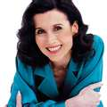
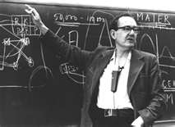
Two different thinking systems
  Type 2- Slower, rational, conscious choice
  Requires attention and effort!
  You really pay attention
Be able to defend your arguments in a rational way. Otherwise, all you have is an opinion.
Anything that gives us new knowledge gives us an opportunity to be more rational.

Slide 11
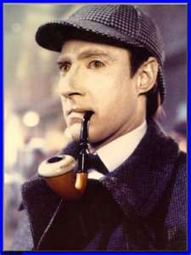
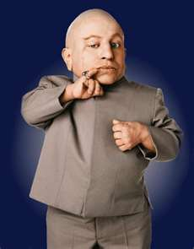
Shouldn’t we always use type 2 thinking?
No
1> if we have experience in a subject
2>and/or the number of items under consideration is storable by short term memory
Then →type I memory will make better decisions!

Slide 12
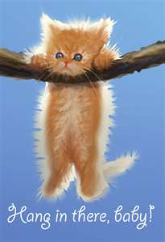
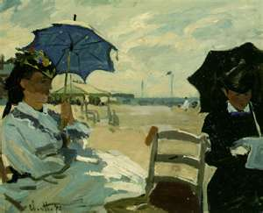
Pictures at exhibition
Experiment- give students a choice of art work
Students pick their favorite and get it for free
  1 group must explain decision first
  1 group just picks
Come back at later date to check on satisfaction of choice
The 2 groups choose different pictures
The ones that picked without explanation were more satisfied with their choice
Yes, sometimes thinking is bad

Slide 13


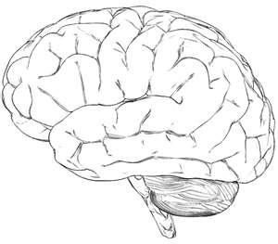
Sometimes your brain knows more than you
What do you mean by that?
Damasio card playing experiment
2 decks of cards
  1 high risk, high reward
  1 low risk, low reward
Person picks cards at random
When the person figures out best option, tells researcher
Took 80 cards on average
Measuring brain at the same time
The brain knew after 10 cards
Physiological changes

Slide 14
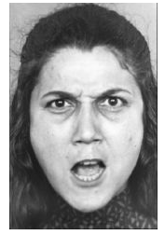
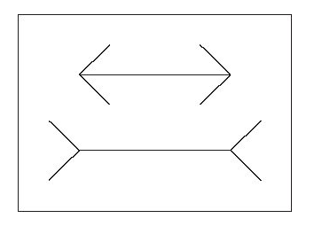
What is a System?
Systems are not a part of brain
Think of non-conscious vs. conscious
Empirically verifiable
Dilation of pupil
Dilation scales with effort
Decreases with Type 2 failures!
These two images never get to your thinking brain
Second Nature of Aristotle
I’m happy!
We have the same length

Slide 15
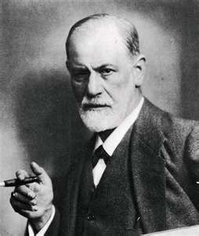
Prime Real Estate
Priming
Seeing something first can change your impression of later items
Unconscious and uncontrollable
You are getting hungry…

Slide 16
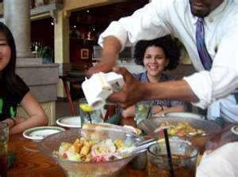
An example
Read the following:
  Olive Garden, bread, wine, salad
Now complete the following word
  S_ _ P
As opposed to
  Dirty, clean, bath, shower,bubbles
Now complete the following word
  S_ _ P
So soup vs. soap

Slide 17
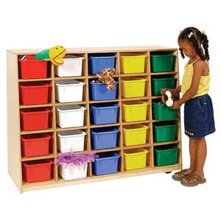
A place for everything
Priming experiments uncover hidden biases
Due to the way the brain actually stores information
The brain stores information as a network of connections and emotional impressions
In a nutshell, this is WHY marketing works
Priming leads to anchoring…

Slide 18
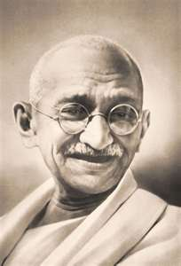
Anchoring
Was I older than 140 years old when I died?
How old was I when I died?

Slide 19
Anchoring
Was I younger than 30 years old when I died?
How old was I when I died?

Slide 20
Anchoring
The first question affects the answer to the second question.

Slide 21
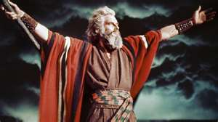
Other anchors
10 Commandments experiment
  People who are asked to name 10 commandments before a test cheat less
  Didn’t need to actually know the 10 commandments-effect was the same

Slide 22

Vacation dreams…
Asked students question on whether they would take a vacation .
Group 1- Said didn’t know grade of test
Group 2-Said knew grade to test
The information of knowing whether they knew their grade on test skewed results
Even more than result of test
So not knowing an answer skewed more than knowing answer

Slide 23
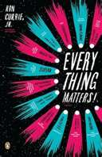
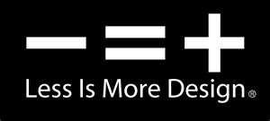
So what does this mean to us…
Everything we put on a page matters
But adding more is not always better
It can distract, influence or confuse the customer
The order of items can change the customer’s opinion

Slide 24
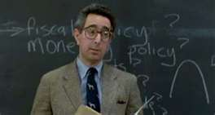
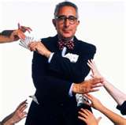
Accounting 101
People put items in different mental accounts
Moving an item to a different account can change it’s value and then in turn behavior

Slide 25
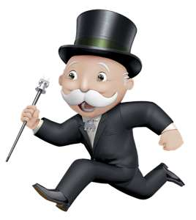
Ultimatum game
You have 10 dollars
You can share this money with person from 0 to 10 dollars
The person can then decide whether to take your offer and you both get paid or reject it and no one gets any money
What do you do?

Slide 26
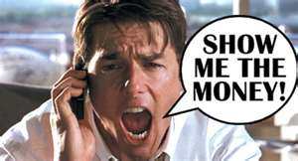
First results
People who give near 50% take home money
People who give up near nothing don’t take home money

Slide 27
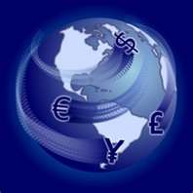
Other cultures
Objection-It is only 10 bucks
Results the same in Indonesia where amount was average 2 week paycheck
Machiguenga tribe of Peru
  quarter of the total amount
  “virtually no offers were refused.”
Au and Gnau tribes of Papua New Guinea
  Better than 50-50
  Rejected
Why? Let’s see some other examples…

Slide 28
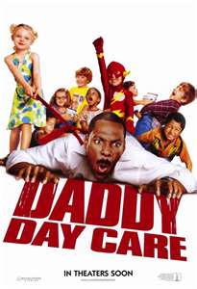
My all time favorite example
Day Care Example
Problem-Parents coming late to pick up kids
Solution- Charge parents for late pickup
Expected Result-parents had incentive to get there on time and tardiness would cease
Result- More parents come in late
Why?

Slide 29

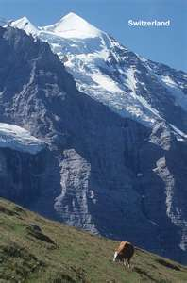
Not so neutral
Switzerland needs to build a nuclear reactor
Ask people from the area if they would support it
A slight majority support it
Decide to give them monetary prize for building the reactor
People who support the idea drops
Why?

Slide 30
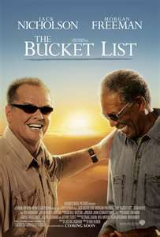
Bucket lists
Economic
  Weigh pros and cons
  What do I get?
Moral
  Weigh personal value for acceptance
  How does it make me feel to do it?
Daycare changed the transaction from moral to economic
Tried to change back to no fees but didn’t matter
Lots of other buckets: Friends, Family, etc.

Slide 31
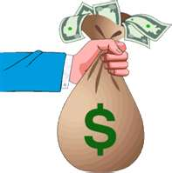
Explaining the other results
In ultimatum game, differences in social standing explains the results
New Guinean gifts were obligation
Mapped closest social custom to new game
In Switzerland, the first item was a matter of being a good citizen, the second an economic decision

Slide 32
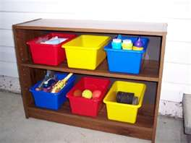
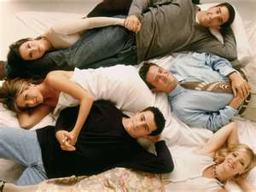
So what???
Presentation of items can influence the person on how to calculate value
Sometimes different buckets mean different customer values
If you move to economic bucket-can’t move back
Customer will only ask what is in it for them
Make friends with all customers

Slide 33
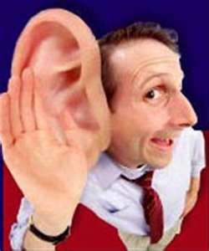
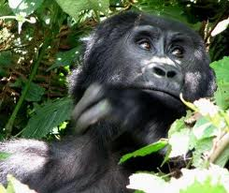
Selective attention
You don’t pay attention to everything
You select certain items and ignore the rest
Counting test

Slide 34
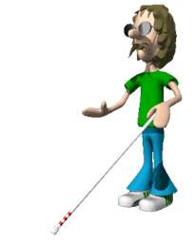
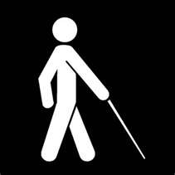
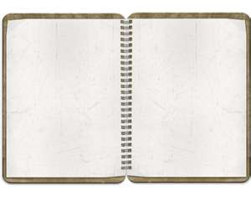
So what????
Just because an item is on a page doesn’t mean the customer will see it
You need to focus the customer to the correct item at hand

Slide 35
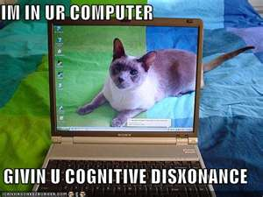
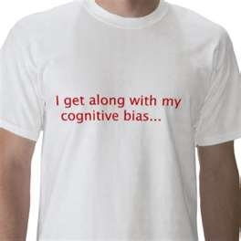
It’s a long list
There are many more documented cognitive biases
Wikipedia lists 43 cognitive biases, 28 biases in probability and belief, 19 social biases, and 11 memory errors and biases
Each means something to a developer
Cognitive Biases
But let’s stop there and go on to show an example of how using cognitive research can help developers

Slide 36
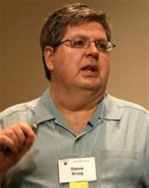

Krug’s first law of usability
When I’m looking at a page that doesn’t make me think, all the thought balloons over my head say things like “OK, there’s the _____. And that’s a _____. And there’s the thing that I want.”

Slide 37

Good Design

Slide 38

Bad Design

Slide 39

How do people really use the web?
FACT OF LIFE #1: We don’t read pages.
We scan them.
One of the very few well-documented facts about Web use is that people tend to spend very little time reading most Web pages
Instead, we scan (or skim) them, looking for words or phrases that catch our eye.
Why are things always in the last place you look for them?
Because you stop looking when you find them!

Slide 40

We don’t make the best choice
We make the first choice that looks right
We don’t scan the whole page and make a decision
This is a strategy known as satisficing.
Economist Herbert Simon coined the term (a cross between satisfying and sufficing) in Models of Man: Social and Rational

Slide 41



Naming conventionally
Make names immediately understandable
. Clever can be confusing

Slide 42


Why??
Making pages self-evident is like having good lighting in a store:
It just makes everything seem better.
Type 1 Systems says “Thinking is easy. Product is good.”
Using a site that doesn’t make us think about unimportant things feels effortless, whereas puzzling over things that don’t matter to us tends to sap our energy and enthusiasm—and time.
Moving from Type 1 to Type 2

Slide 43



FACTS OF LIFE
We don’t figure out how things work.
We muddle through.
User creates idea of how it works
Best apps match user’s thoughts
The path is narrow here
Why are they changing direction?

Slide 44

Billboard Design 101
Design web pages for scanning not reading
Create a visual hierarchy
When we scan we interpret things like this automatically

Slide 45

We’re related!
Things that are related logically are also related visually.
Remember the librarian, I mean the farmer?

Slide 46

The Nesting Instinct
Things are “nested” visually to show what’s part of what.

Slide 47

Result
Newspaper already use these ideas

Slide 48






Other important tips
Make what is clickable obvious!
Keep the noise down to a dull roar
Don’t click me!

Slide 49

Why users like mindless choices
KRUG’S SECOND LAW OF USABILITY
It doesn’t matter how many times I have to click, as long as each click is a mindless, unambiguous choice.
Move to System 2 requires effort
Humans equate ease of effort with worth
  Emotional shotgun
  When answer is hard, we ask an easier question
.

Slide 50


Vigorous writing is concise. A sentence should contain no unnecessary words, a paragraph no unnecessary sentences, for the same reason that a drawing should have no unnecessary lines and a machine no unnecessary parts.
William Strunk, Jr., and E B. White, The Elements of Style (Allyn and Bacon, 1979).

Slide 51


How do I do that?
Your objective should always be to eliminate instructions entirely by making everything self-explanatory, or as close to it as possible.
When instructions are absolutely necessary, cut them back to the bare minimum.
Remove happy talk!
Remove Instructions →

Slide 52

103 Words

Slide 53



Hmm….
What do you think of this direction?

Slide 54



How about this?

Slide 55



And maybe this..

Slide 56



And then again …

Slide 57



Lastly

Slide 58

Better
Please help us improve the site by answering these questions. It should only take you 2-3 minutes to complete this survey. NOTE: If you have comments or concerns that require a response don’t use this form. Instead, please contact Customer Service.

Slide 59

Is this the end?
There is a lot more in the book-Read it!
What concepts of human cognition did he use?
Remove distractions because distractions change behavior
More is not always better
What you see prior to anything effects how we feel about the things we see after the fact
Remember thinking is NOT an option- Type I is always working

Slide 60






















Some books for fun

